Slide 1
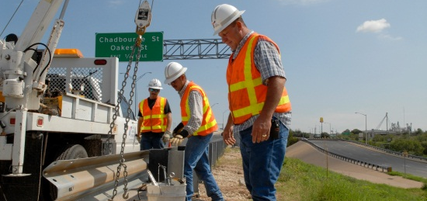
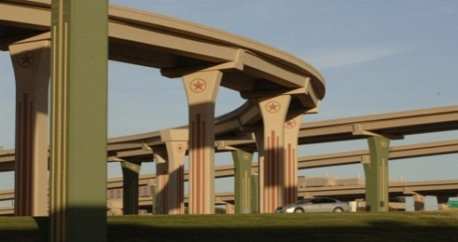

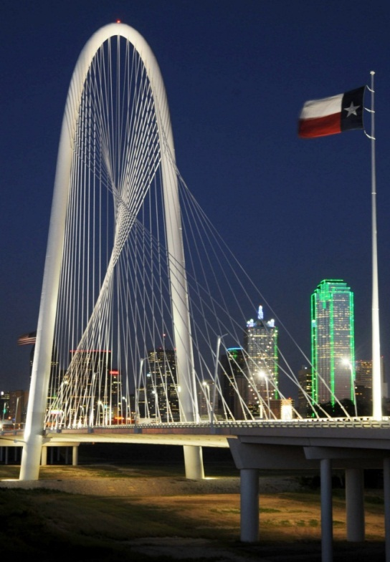
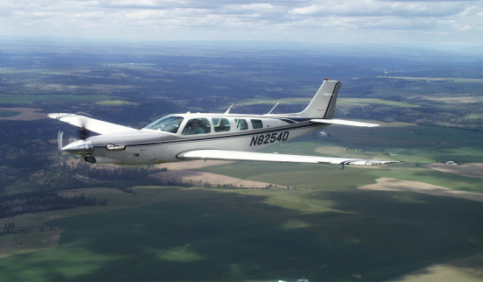

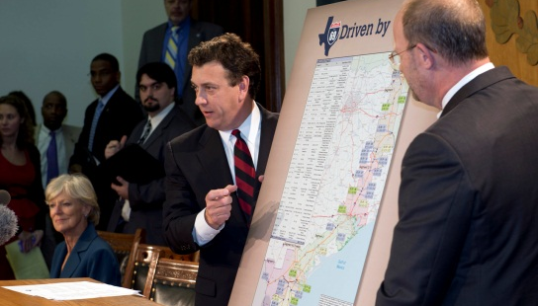
US 181 Harbor Bridge
Project
Public Hearing
February 18, 2014

Slide 2
Tonight’s Agenda
Welcome and introductions
Project History and Background
Need and Purpose for Project
Key findings of Draft EIS
The Preferred Alternative
Proposed Park Improvements
Proposed Environmental Justice Mitigation
Next Steps
Public Comment Period

Slide 3
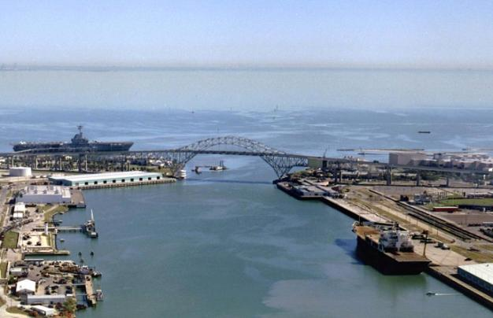
Why are we here tonight?
Purpose:
To provide an opportunity for public comment on the proposed project, including the preferred alternative
To provide a public forum for presenting views on the social, economic, environmental, and other potential effects

Slide 4
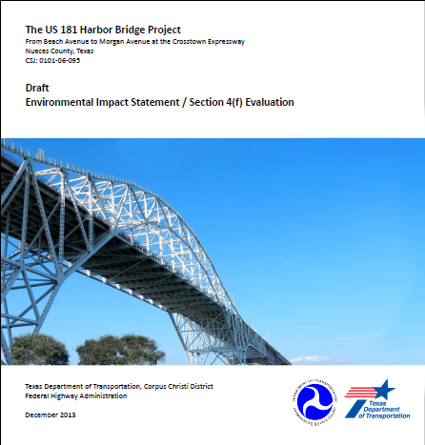
US 181 Harbor Bridge Draft EIS/Section 4 (f) Evaluation

Slide 5
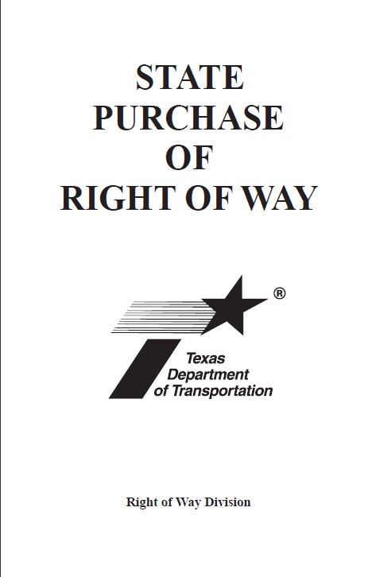
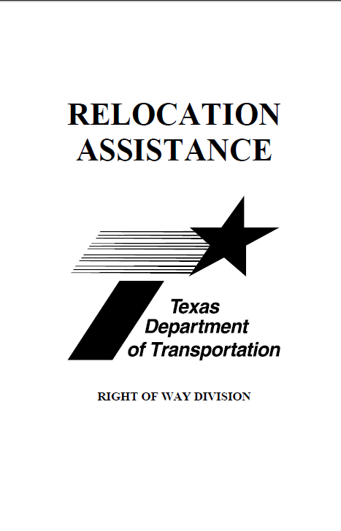
TxDOT’s Right-of-Way Acquisition Process

Slide 6
Hearing Procedure
Public hearing part of open comment period (Jan 3 – Mar 3, 2014)
We are receiving comments tonight according to TxDOT public hearing procedure. (Questions answered during open house portion of hearing only)
Hearing report will provide responses to all recorded comments (both verbal and written)
Meeting packets available tonight
Opportunity to speak during the comment session that follows this presentation
Comments also may be written or dictated to the court reporter tonight or submitted in writing, via email, or online until March 3.

Slide 7
What is the Harbor Bridge Project?
Replacement of Harbor Bridge
Reconstruction of portions of US 181, I-37 and Crosstown Expressway
Would include reconstruction of I-37/Crosstown interchange
Would not add travel lanes but would include a new shared use bicycle/pedestrian path
Estimated construction cost is $558 – 679 million in 2013 dollars
Estimated date of completion is 2020

Slide 8
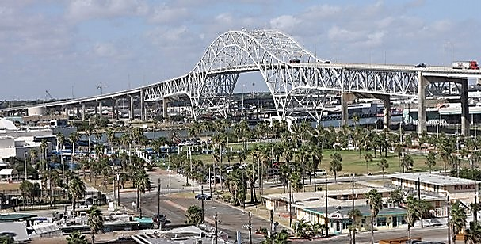
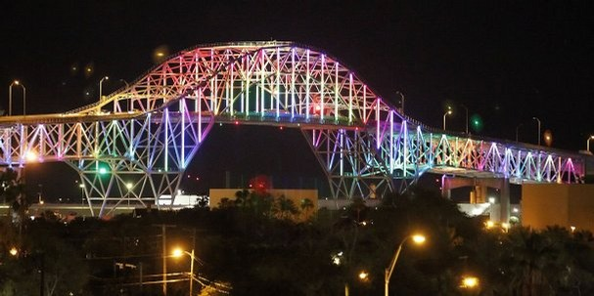
Harbor Bridge Project History
2003 – Completed Feasibility Study to evaluate options for crossing the ship channel
2005 – Began EIS and schematic (design) development process including public involvement
2007 – Expanded project to include managed (tolled) lanes
2011 – Project reduced to bridge replacement (no tolled lanes); public and agency scoping meetings held to get feedback
2012 – Citizens and Technical Advisory Committees reinstituted, neighborhood meetings held; held public meeting in December
2013 – Draft EIS completed and additional public involvement conducted with stakeholders
2014 – Draft EIS published and additional public involvement offered
Photo: Caller-Times

Slide 9
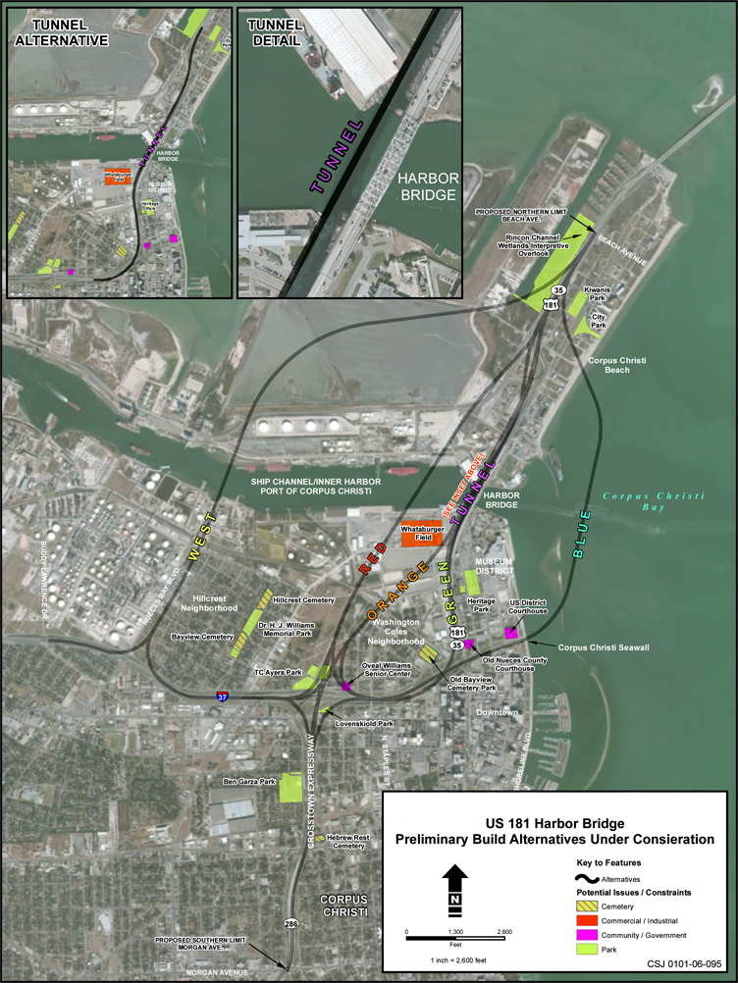
Six Preliminary Alternatives and No-Build Alternative Identified

Slide 10
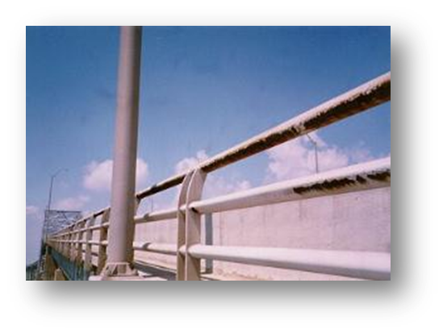
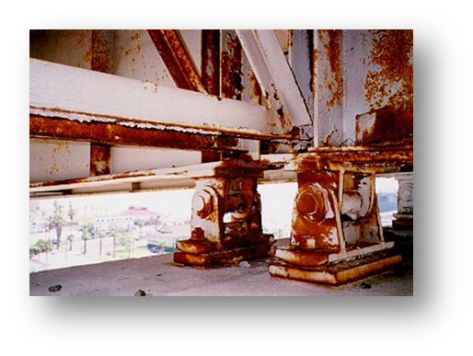
Project Introduction
Proposed replacement of the existing US 181 Harbor Bridge over the Corpus Christi Ship Channel
Need for the proposed project
  Improve Safety
    Geometry
    Road Grade
    Shoulders
    Hurricane Evacuation
  Long term maintenance and operation
    Steel Structure Over Salt Water
    Fracture Critical
    Decrease Overall Maintenance Cost
    Reduce Potential Roadway Closures

Slide 11
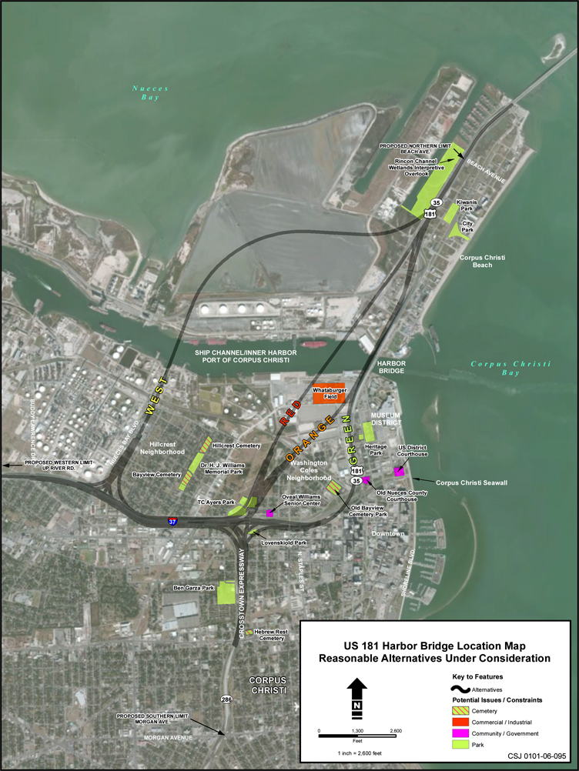
Six → Four Reasonable Alternatives Considered in Draft EIS

Slide 12
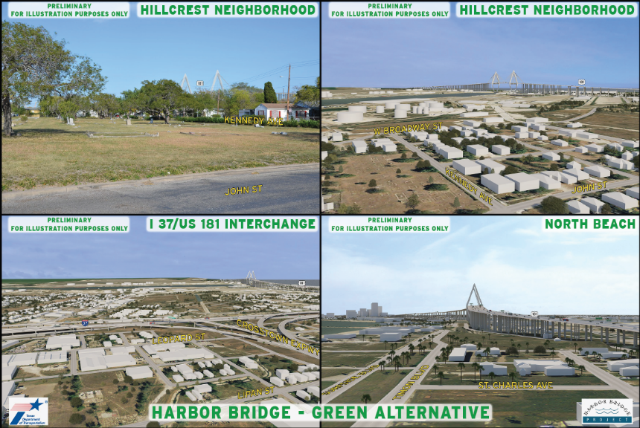
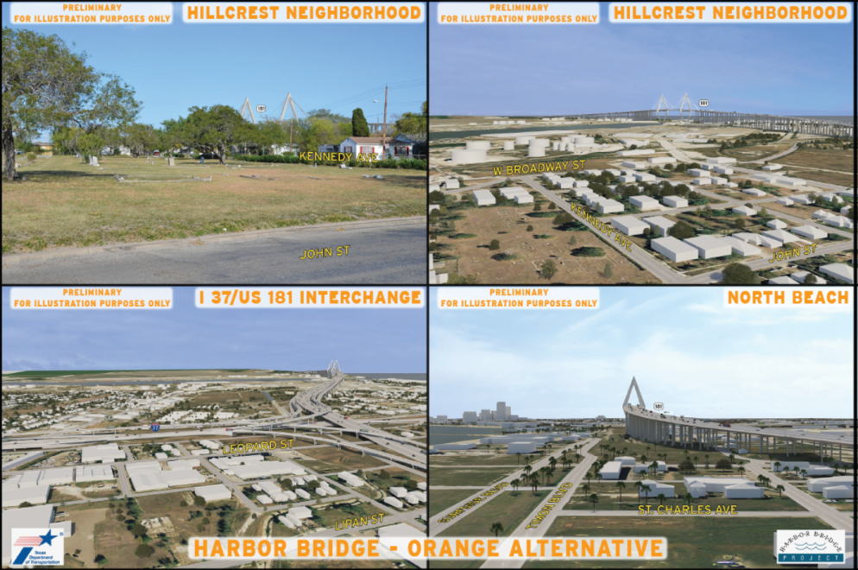
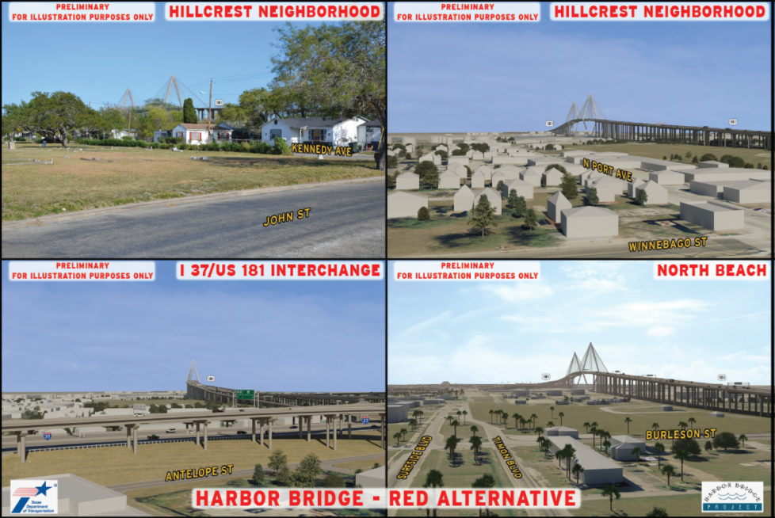
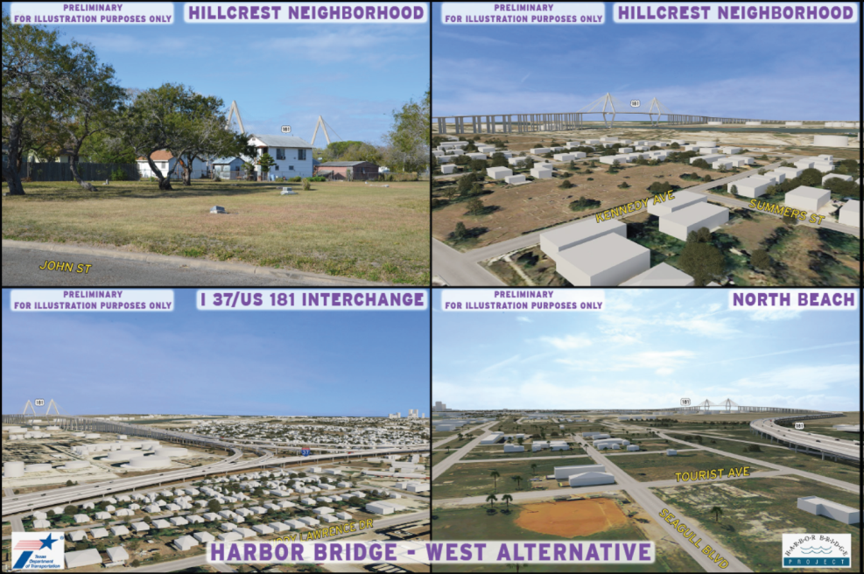
Visualizations of Alternatives

Slide 13
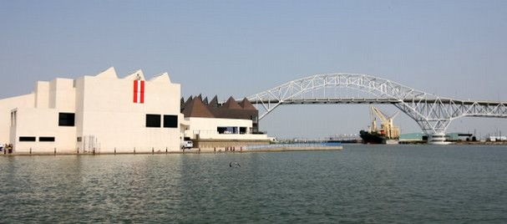
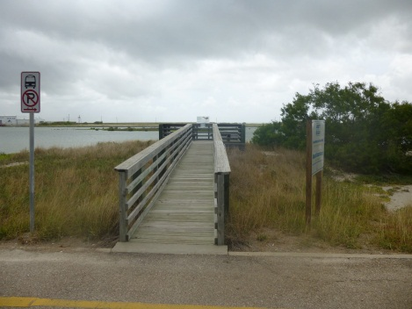
Key Findings of Draft EIS/Section 4(f) Evaluation
Four reasonable alternatives plus no-build alternative evaluated
Impacts on environment and community assessed
Substantial input received from public regarding four alternatives
Although avoidance and minimization of impact on local parks, recreational areas, wildlife refuges, and historic properties was the goal, all alternatives would have some impact.
Draft EIS identifies a preferred alternative.
  Best meets need and purpose of project
  Has least overall harm
  Has greatest potential for lessening the effects of impacts on environment and community with mitigation
  Maximizes engineering considerations

Slide 14
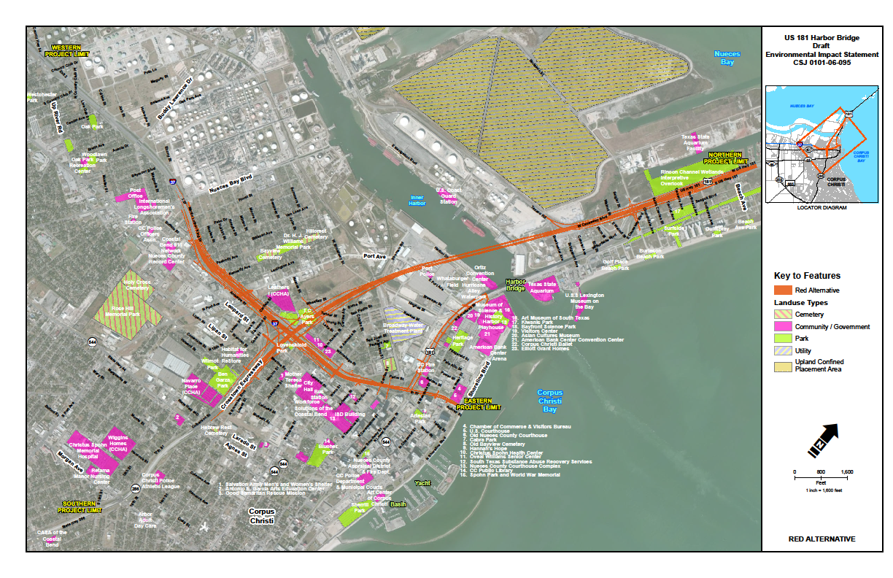
The Preferred Alternative – Red Alternative

Slide 15
Why the Red Alternative?
Best meets Need and Purpose for project (safety, long-term operation)
Preserve & improve much of existing connectivity between the facility and surrounding neighborhoods
  Includes all modes of transportation
Maximizes engineering considerations and accommodates navigational transportation needs of the Port of Corpus Christi
Resolutions endorsing the preferred alternative have been passed by
  Nueces County
  City of Corpus Christi
  Corpus Christi Metropolitan Planning Organization (MPO)
  Port of Corpus Christi
  Corpus Christi Regional Transportation Authority (RTA)
Definitive decision will be made by FHWA with a Record of Decision (ROD)

Slide 16
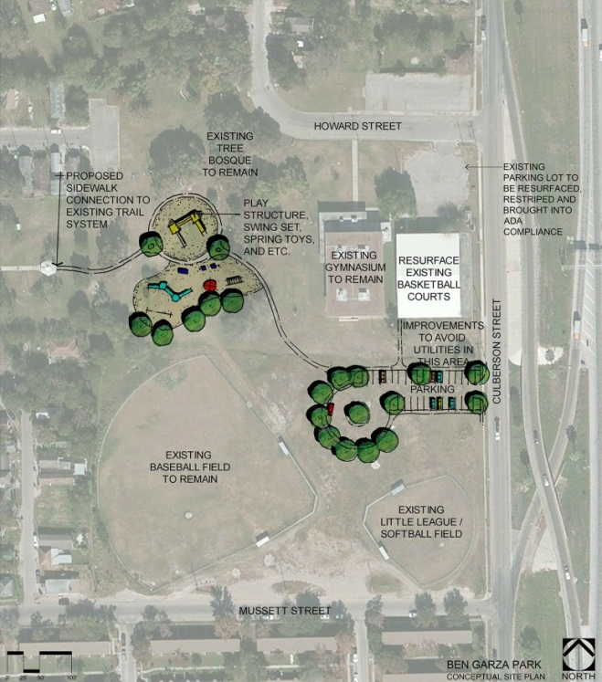
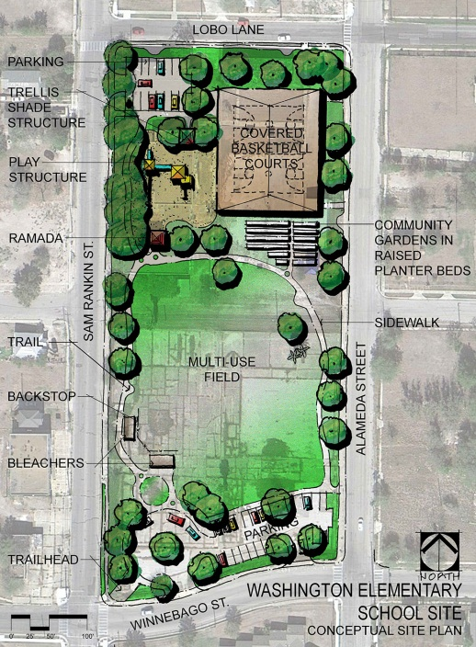
Park Improvement Concepts
Designed to reduce effects of project impacts to community
Proposed improvements to:
  TC Ayers Park
  Rincon Channel Wetlands
  Dr. HJ Williams Memorial Park
  Ben Garza Park
New park at Washington Elementary
School site
New walking trail to connect
all parks on Northside

Slide 17
Proposed Environmental Justice Mitigation
Workforce support for those affected by residential and business relocations
Recreational improvements for neighborhoods
Opportunities for neighborhood residents to provide input in design of areas around bridge/roadways
Support for improving neighborhood streets (including bicycle/pedestrian improvements)
Identification of additional housing and transportation options, and economic opportunities
Local Transportation Planning that focuses on minority and low-income communities

Slide 18
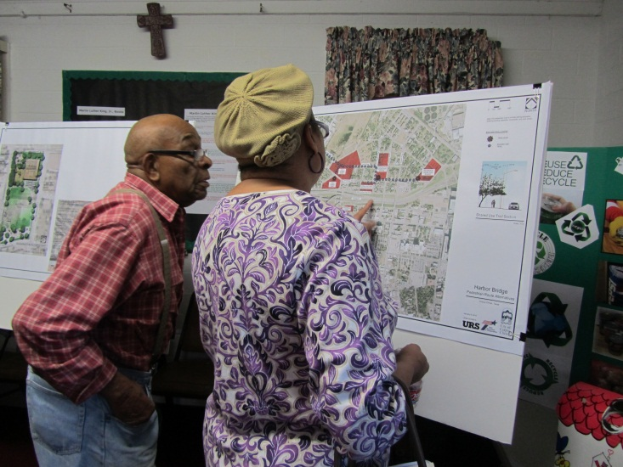
Public Involvement Key to Project Development
Citizens’ and Technical Advisory Committee meetings since 2007
Neighborhood meetings in 2007
Project website
Project newsletters
Public scoping meetings held in 2011
Neighborhood meetings in Fall 2012
Public Meeting in December 2012
Neighborhood meetings on proposed
park mitigation in 2013
Meetings with local organizations and stakeholder groups at request
Eight neighborhood open house meetings on Draft EIS in January 2014
“Storefront” meetings with TxDOT project managers every Tuesday and Thursday from Jan 7 to Feb 27, 2014

Slide 19
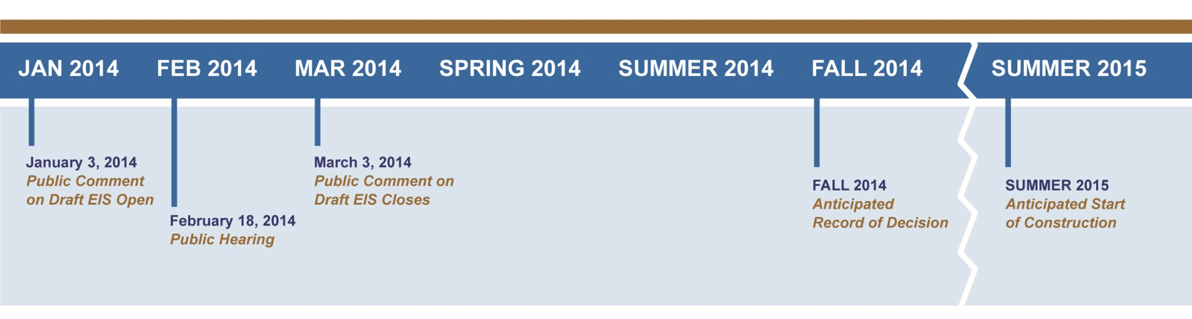
Next Steps
After holding public hearing and considering comments received, TxDOT and FHWA will determine whether the Preferred (Red) Alternative should be moved forward for selection.

Slide 20
Public Comment Period
Sign up to speak with a speaker card (raise your hand if you need one).
To allow everyone a chance to speak, please keep your verbal comments to three minutes.
To submit a written comment, please:
  Fill out a comment card here tonight or mail it to us later
  Send us a comment via email at HarborBridgeDEIS@urs.com
  Fill out an online comment form at www.ccharborbridgeproject.com
To dictate a comment, visit the court reporter here tonight.
The public comment period ends on March 3, 2014. Storefront meetings at the library and Oveal Williams Center will be held through Feb 27.

Slide 21
Conclusion and Adjournment
  Thank you for joining us tonight

